Slide 1
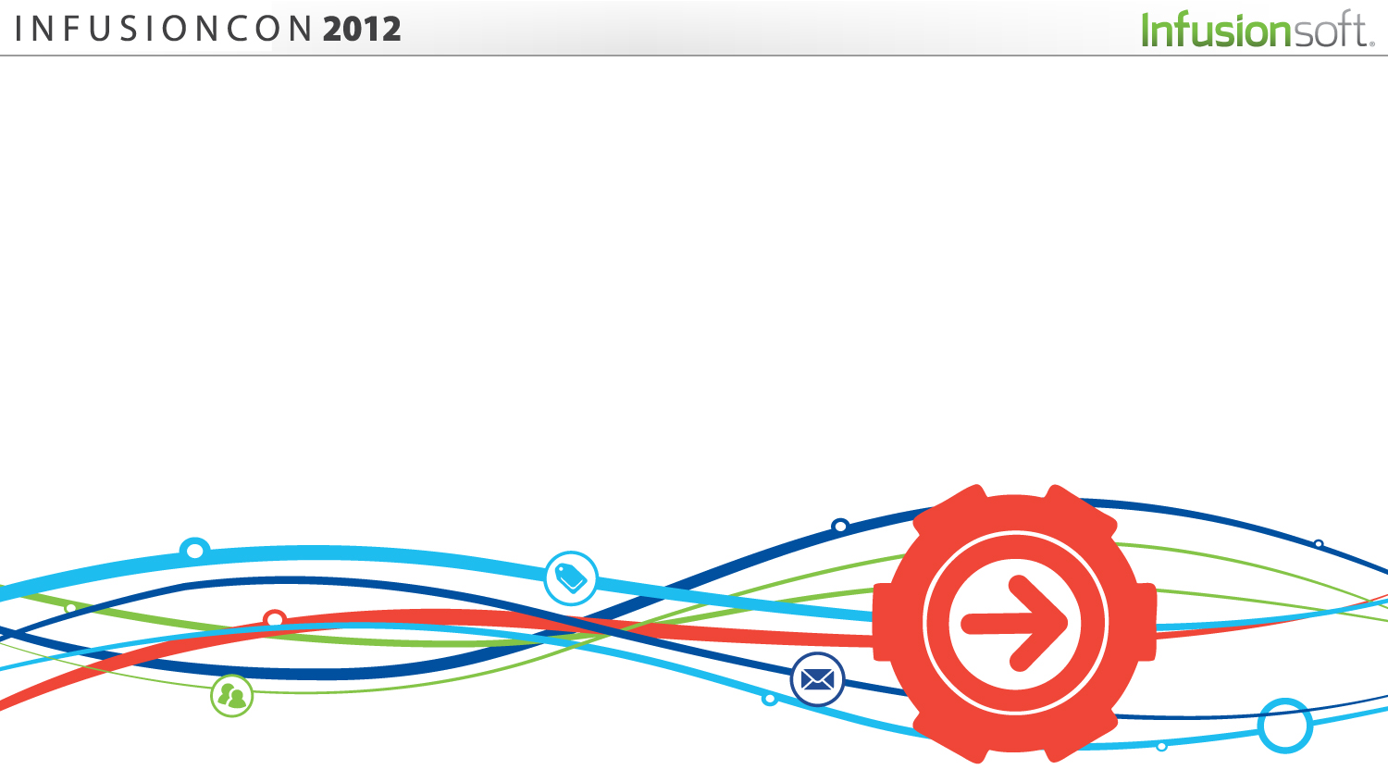
How Professionals Use Infusionsoft® to Capture Prospects, Convert Leads & Turn Clients Into Raving Fans Who Stay, Pay and Refer.

Slide 2
Capture Prospects
Capturing Prospects and Developing an Ongoing Relationship With Them is the LIFEBLOOD of Your Practice

Slide 3
Make Capturing Prospects (Generating Leads) Priority #1
Every Time You Get a Phone Call, Give a Talk, Appear on Television or Radio, Use Social Media, or Attend a Networking Event – Make Prospect Capture Your #1 Priority

Slide 4
How to Capture Prospects
#1: When You Talk – Use a Lead Capture Worksheet, PresentNow.me, OR (Make It About Them!)

Slide 5
How to Capture Prospects
#2: When You Appear in the Media –
Drive Them to a Opt-In Page That Gives Away Something Highly Valuable – See http://www.KidsProtectionPlan.com

Slide 6
How to Capture Prospects
#3: On Social Media – Send Fans and Followers to a Social Media Specific Opt-In Offer (Example: http://epw.me/twitter)

Slide 7
How to Capture Prospects
#5: Every Phone Call That Comes In – Use a Call Log to Auto-Enter All New Contacts Into Infusionsoft®

Slide 8
How to Capture Prospects
#4: When Networking – Enter All New Contacts Into Your Database
(Be Sure to Tell Them You Are Going to Do it In Advance!)

Slide 9
Convert Leads
Converting Leads Is All About Building a Relationship With the People In Your Database

Slide 10
Lead Conversion is Easy With Automated Personalization
Welcome Every New Prospect, Touch Them At Least Weekly By Email & Monthly By Mail, Make Special Offers Periodically

Slide 11
How to Convert Leads
#1: Welcome Every New Prospect With a Personalized Email & Welcome Letter Telling Them Exactly What to Expect From You – Then Exceed Expectations

Slide 12
How to Convert Leads
#2: Send Out a Weekly Email Newsletter (or At Least Twice a Month) – and Make it Personal, NOT DRY & BORING!

Slide 13
How to Convert Leads
#3: Send a Monthly Newsletter By Mail. Don’t Cheap Out Here. And Keep It Fresh, Fun and Interesting.

Slide 14
Turn Clients Into Raving Fans
It’s So Easy to Deliver a “Custom” Client Experience With Infusionsoft®

Slide 15
Raving Fans Stay, Pay & Refer
Create a Custom Client Experience, Recurring Revenue Business Model, and Make Referrals Welcome & Easy

Slide 16
How to Turn Clients Into Raving Fans
#1: Create a Custom Client Experience – Series of Automated Communications When a New Client Signs Up With You

Slide 17
How to Turn Clients Into Raving Fans
#2: Recurring Revenue Business Model – Make the Shift. Your Clients Pay You to Stay in Touch

Slide 18
How to Turn Clients Into Raving Fans
#3: Make Referrals Welcome & Easy – Request in Post-Service Survey, Recognize in Newsletters and Reward With a Donation to Charity

Slide 19
To Get This Presentation, the PFL Way™ Implementation Plan & the Lead Capture Worksheet:
GRAB YOUR SMART PHONE NOW
GO TO http://budurl.com/infusioncon
ENTER YOUR FIRST NAME & BEST EMAIL

